Slide 1

AI-Assisted Secure Messaging System
School of Computer Science and Engineering
Department of Computer Science and Engineering
Submitted By:
Keshav Khandelwal
2427030517
Supervised By:
Dr. Rajat Goel

Slide 2
Outline
Introduction
Literature Review
Problem Statement
Proposed Solution
Objectives
Results

Slide 3
Introduction
Cryptography ensures secure communication using encryption techniques like AES-256, but many security failures still occur due to human errors.
This project proposes an AI-assisted secure messaging system that detects such errors and provides real-time warnings. It enhances cybersecurity by combining strong encryption with intelligent decision-making.

Slide 4
Literature Review
Existing research shows that cryptographic techniques like AES provide strong data security, but many failures occur due to human and implementation errors.
Studies also highlight that AI-based systems can detect anomalies and user behavior patterns effectively. Therefore, combining cryptography with AI can significantly improve secure communication systems.

Slide 5
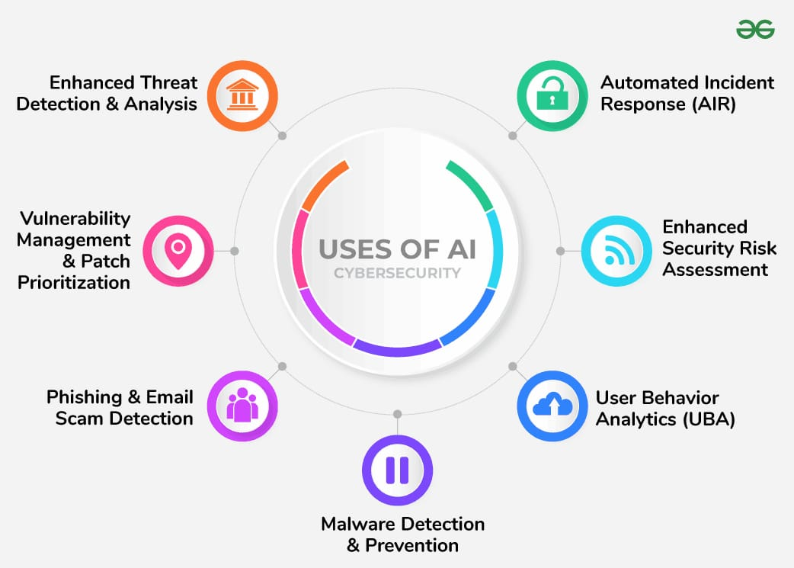

Slide 6
Problem Statement
Secure messaging systems use strong cryptography.
But human errors still cause security breaches.
Examples:
Sending message without encryption
Weak passwords sending to wrong recipient
Existing systems are reactive, not intelligent.
Need for AI-based proactive system

Slide 7
Proposed Methodology
AI-assisted secure messaging system
Combines:
1. AES-256 encryption
2. AI-based anomaly detection
Provides:
1. Automatic encryption
2. Real-time alerts
3. Error prevention

Slide 8
System Architecture
Components:
User Interface
AI Detection Module
AES Encryption Module
Message Transmission Module
Receiver Module

Slide 9
Algorithm Selection
AES-256 is a symmetric encryption algorithm
Key size: 256-bit (very strong security)
Used in:
Banking systems
Military communication
Secure messaging apps

Slide 10
Advantages for using AES-256:
Fast and efficient.
Highly secure.
Resistance to brute-force attacks.
Best choice for message encryption.

Slide 11
Sender-Side Process
Enter message and recipient
AI checks:
(i) Weak Password
(ii) Sensitive content
(iii) Invalid recipient
3. Generate AES-256 key
4. Encrypt message
5.Generate integrity hash
6. Send encrypted message

Slide 12
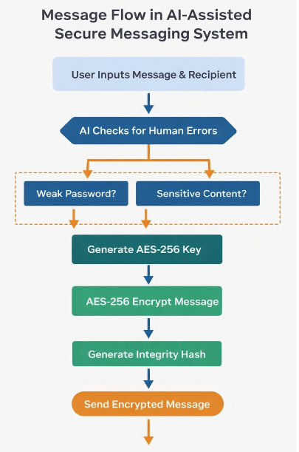
Flow of Message

Slide 13
Warning Detection & Response Mechanism
Warning
AI Detection
System Response
Suspicious Pattern

Slide 14
Anomaly List
AI detects the following issues:
Weak or predictable cryptographic keys
Use of insecure algorithms (DES, RC4, MD5, SHA-1)
Unusual access to key vaults
Sudden spikes in decryption failures
Unauthorized system access attempts
Abnormal file encryption patterns

Slide 15
Result
Secure message transmission achieved
Human errors reduced
Real-time detection working
System improves cybersecurity

Slide 16
Conclusion
Cryptography alone is not enough
Human errors are major vulnerabilities
AI + AES-256 improves security
System provides proactive protection

Slide 17
Objectives
To design a secure messaging system using AES-256.
To detect human errors using AI.
To provide real-time warnings.
To improve secure communication.

Slide 18
Outcome
Working prototype developed
Can be extended to real-world system
Suitable for:
Research paper
Deployment
Further innovation

Slide 19
References
A. Kahate, Cryptography and Network Security, McGraw Hill, 2011.
W. Stallings, Cryptography and Network Security, 6th Ed., Pearson.
Schneier, Applied Cryptography, Wiley.
Anderson, Security Engineering, Wiley.
Forouzan, Cryptography and Network Security, McGraw-Hill.
Stallings, Network Security Essentials, Pearson.

Slide 20
Thank You

